Slide 1
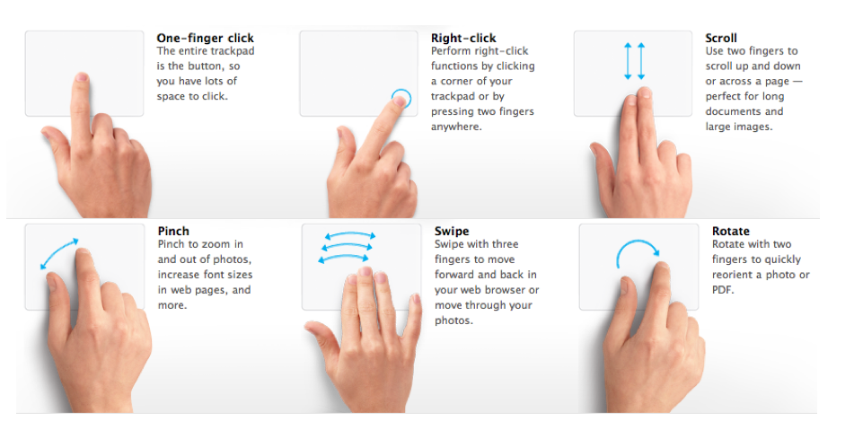
Contextual gesture recognition and prediction
Currently only predictive text applications
Utilizes gesture fitness and user history to predict

